Slide 1
LEARN QUICKLY Presentation
WHAT IS LEARN QUICKLY ALL ABOUT

Slide 2
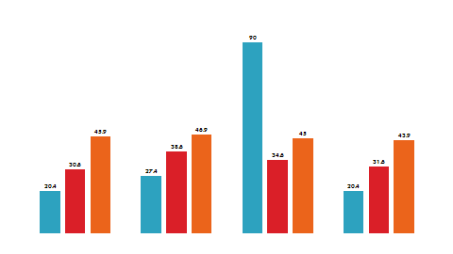
What Is Learn Quickly
Lets Start from Nelson Mandela quote “Education is power”
For several years many countries educational sector is low
In so case we have a greater population of uneducated youth in our society being non educated may end up doing illicit things
Thereby increasing the crime rate in our society

Slide 3
What is Learn Quickly
Learn Quickly (LQ) is an organization with the aim of Enhancing students willingness to learn and improving students ability to learn faster by organizing different varieties of activities to test their individual abilities, hosting competition and tournaments that will push them to perform better, put them in groups, promote co-operation and team work bringing people together.
Not only that tutorial are also present for students who do not understand what is taught in class where the can watch our tutors teach there.

Slide 4
Features Of Learn Quickly
The Aims of Learn Quickly are as follows:
Education & Tutorial
Organizing Quiz competition
Testing Students Abilities to recall what they have learnt
Hosting group involving Tournaments to promote Co-operation among Students

Slide 5




Social Media Links
@ Learn Quickly

